Slide 1
ACME Co. Network Evaluation
Created by:
h. Morgan jordan

Slide 2
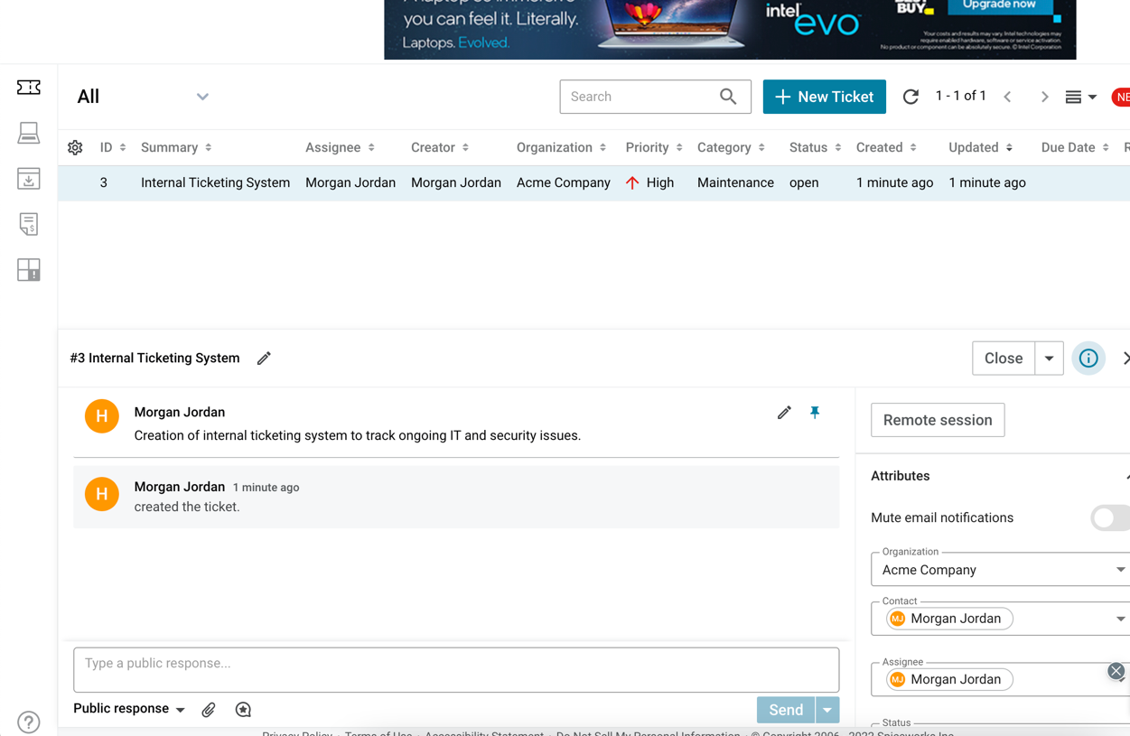
Internal ticketing system
SpiceWorks
Free online ticketing system
Allows us to track and monitor any outstanding/discovered IT and security issues

Slide 3
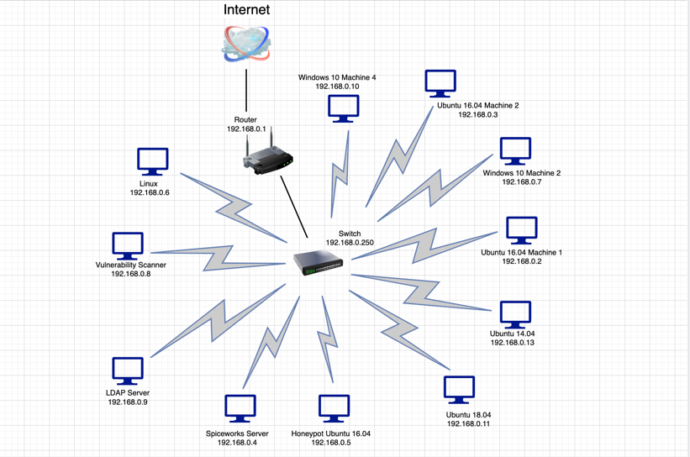
Network diagram update
Now shows appropriate, current asset information
Satisfies the first step in NIST CSF
Firewall is no longer in place – severe security/non-compliance issue
PCI DSS requires Firewall to secure network where transactions are conducted

Slide 4
Risk Assessment
Collects and tracks all security related issues in one place
Will be continuously updated, maintained and reviewed
Provides:
Cost approximations
Benefits provided
Timelines for implementation
High/Med/Low estimate

Slide 5
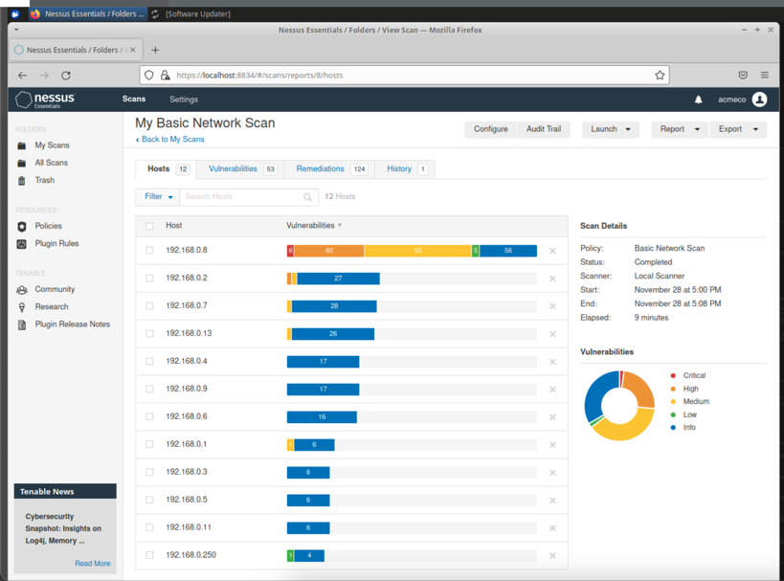
Vulnerability scan
Nessus - free program used to scan networks for vulnerabilities
Majority of issues found were lack of updating programs within the network
PCI DSS states that systems should be protected against malicious attacks by frequently updating programs in place as well as installing offered patches routinely

Slide 6
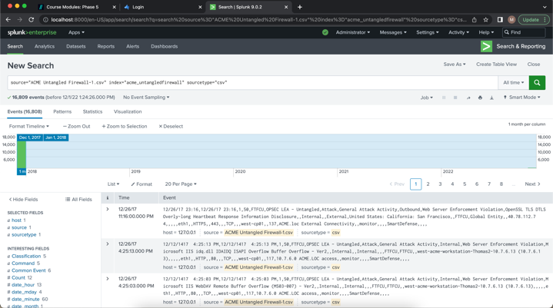
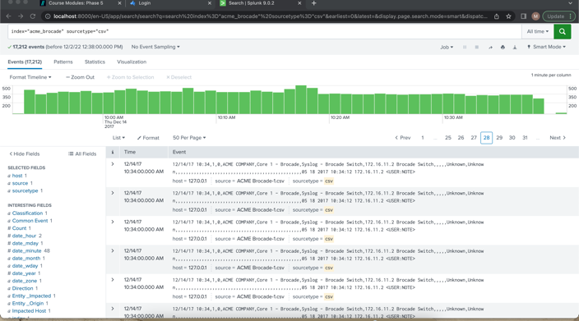
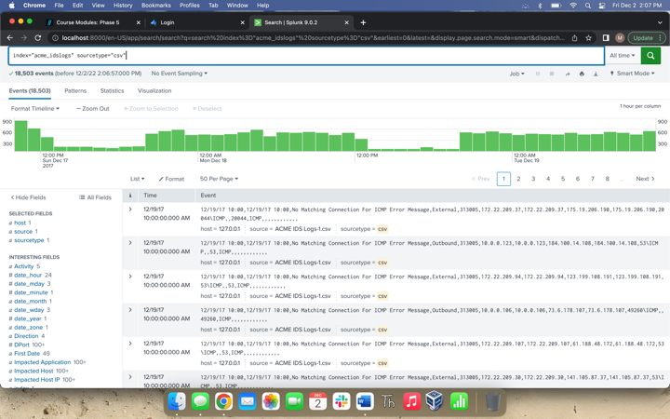
Log file evaluation
SIEM – Splunk Enterprise
Unknown access to Brocade Switch – 12/14/17 10:33-10:34AM
Firewall
Buffer overflow attacks on Thomas2 (10.7.6.13), ACME.LOC access
Malicious URL Directory Traversal on Jessica7 (10.0.0.15), ACME.LOC access
IDS
12/18/17 0600 EXT HTTPS TCP 443
12/18/17 0700 EXT TCP Unknown Port
12/18/17 0800 OUT DNS UDP 53
12/18/17 0800 OUT SSH TCP 22

Slide 7
Open-source intelligence remediation plan
Strategy to safeguard all sensitive data that could potentially be shared publicly
How to collect, analyze, and reduce OSINT breaches
PCI DSS states that cardholder information must be protected wherever it is stored (secure, encrypted). Access to this information should also be restricted and controlled.
Also complies with GDPR and NIST CSF

Slide 8
External threat feeds
When implemented with a SIEM, greatly reduces risk and increases efficiency of current appliances within a network
Repository of Open-Source Cyber Threat Intelligence feeds that are in STIX format and can be integrated with our SIEM (Splunk Enterprise)
Able to set-up conditions, actions, and alert criteria to notify appropriate staff of potential suspicious activity

Slide 9
Security plan with timelines
Current low security posture
Created multi-year plan to improve security maturity and reduce risk
Year one - create and maintain an asset inventory, rank and prioritize risks, educate employees on security best practices, create and maintain an Incident Response Plan, and continuously review gaps in our security controls
Following years - focus more on having routine reviews and training to continually mature our security posture
Maintains compliance with PCI DSS standards

Slide 10
Incident response plan
Document that helps guide any employee in how to proceed if and when they encounter a security incident
Key points:
Current system diagram
Incident Response Team contact information
Incident response procedures
Complies with NIST CSF (detect, respond, recover)

Slide 11
Internal honeypots
Early indication of malicious activity allowing us to detect and deflect attacks
Cowrie - open source, moderate interaction SSH and Telnet honeypot written in Twisted that can log brute force attacks and an attacker’s shell interaction
Gains information on how the attacker is operating and/or distracts them from other targets
Cowrie automatically outputs event data to text and JSON log files, allowing us to monitor traffic/activity via our SIEM (Splunk Enterprise) and set-up alerts to the proper staff

Slide 12
Web services
Integrating website, router and firewall logs with Splunk Enterprise will allow us to properly monitor our web services
Splunk Enterprise can process logs and alert necessary staff of any malicious activity within our network or on our website

